Slide 1
Iterative/Looping
statements

Slide 2
Iterative construct/ Loop
A construct in which a block of statements gets executed repeatedly unless the required task has been completed, is known as an Iterative construct or a Loop.
Iteration means repeated execution of a set of statement. This can be achieved by using a loop.
Loop statement helps the programmer to execute the set of instructions repeatedly

Slide 3
In java we have different types of loop statements, they are:
1) while loop
2) do-while loop
3) for loop
4) for each / advanced for / enhanced for
5). nested loop

Slide 4
while Loop
In while loop, a set of instructions are to be executed repeatedly without knowing the number of iteration.
This loop can be applied to a program where number of iteration are not fixed.
while is a conditional controlled loop.
The loop will continue executing till the condition is true.
The control terminates when the test condition is false.
Syntax to create while loop:
while(condition)
{
Statement to be repeated ;
}

Slide 5
WORKFLOW:
CASE 1: When the condition is true
The loop continues.
Control execute the statement which belongs to the loop.
After execution once the loop block ends, control goes back to the
condition and the entire process will be repeated till the condition becomes false.
CASE 2: When the condition is false
The loop is stopped i.e. repetition is stopped.
The loop block will not get executed.
The control comes outside the loop to the next statement

Slide 6
do while
do while loop is used in a program where number of iteration is not fixed.
In this looping construct condition is checked at the exit point of the loop.
Syntax to create do-while loop :
do
{
//statement
}
while(condition) ;

Slide 7
WORKFLOW :
CASE 1 : When the condition is true
● Control goes to the loop block directly , execute the instructions.
● Then control goes to the condition, if the condition is true the control goes back to the do block.
CASE 2: When the condition is false
Control goes to the loop block directly, execute the instructions.
Then control goes to the condition, if the condition is false the loop is stops and control goes to the next statement.

Slide 8
for loop
In for looping construct, the statements are repeated for a fixed number of times.
The control terminates after repeating the statement for given number of times.
All the three segments are optional (Initialization, condition, update).
If the condition is not provided, by default it is considered as true.
for(initialization ; condition ; update)
{
// statement to be repeated
}

Slide 9
WORKFLOW:
Step 1: Control go to the initialization part.
Step 2: Then it will go to the condition part.
Step 3: If the condition is true then it will enter inside the loop block.
Step 4: Once the execution of instruction inside the loop block is completed control will go to the update segment.
Step 5: Then it will go back to the condition. Step1,2,3,4 will continue until the condition become false.

Slide 10
INFINITE LOOP
A loop which never ends is referred as Infinite or endless loop.
Eg 1;
int a=10;
for( ; ; )
{
System.out.println(a);
}
Eg 2;
int a;
for(a=1; a<10; )
{
System.out.println(a);
}

Slide 11
Null loop
A for statement which does not include any statement as body of the loop is called Null loop or empty loop.
E.g. 1
for (int a=1;a<=10;a++);
E.g. 2
for(int a=1;a<=10;a++)
{
}

Slide 12
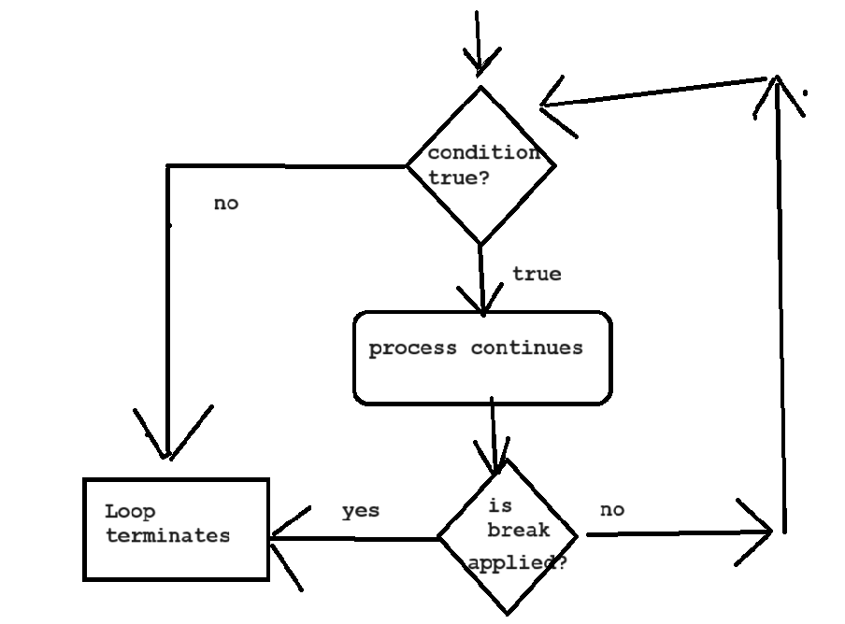
Use of break statement
A break statement is used for unusual termination of a loop. As soon as you apply break statement the control exits from the loop block.

Slide 13
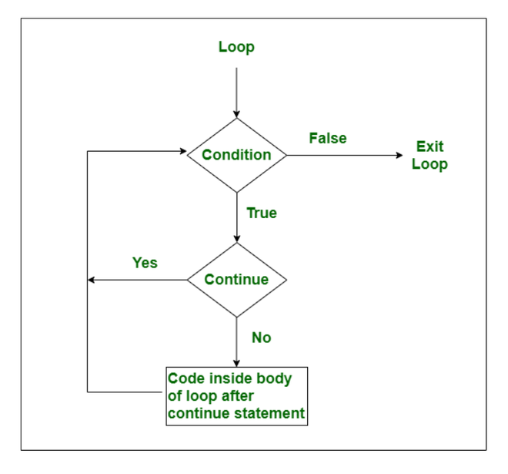
Use of continue statement
The continue statement is just the opposite of break. As soon as continue statement is executed in a loop, the control skips the rest of the statement for that value and resumes next iteration.

